Slide 1
SAP HANA Cockpit 2.0

Slide 2
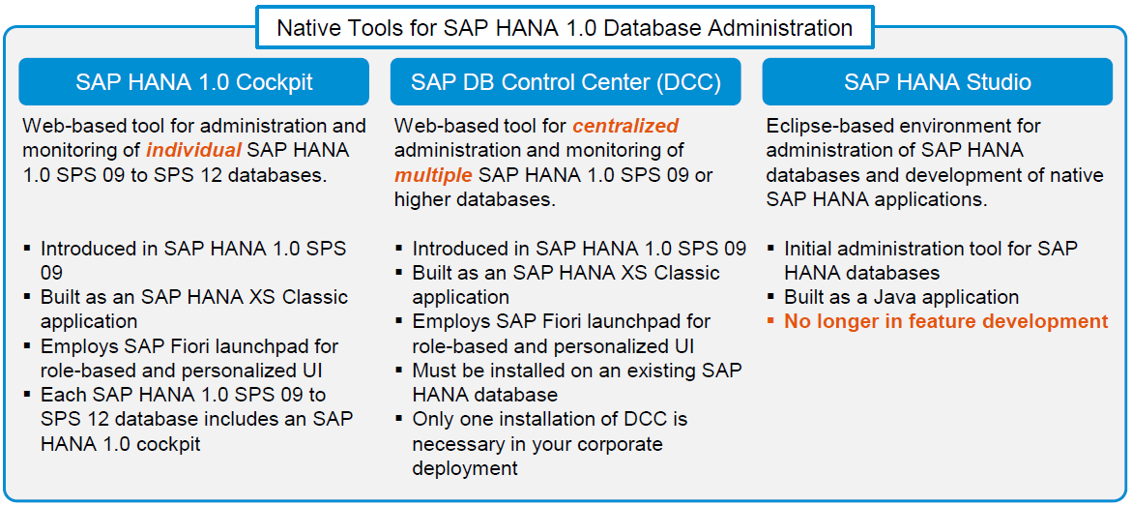
Native SAP HANA administration tools – SAP HANA 1.0

Slide 3
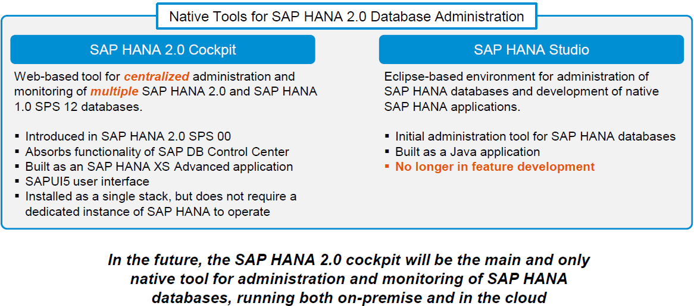
Native SAP HANA administration tools – SAP HANA 2.0

Slide 4
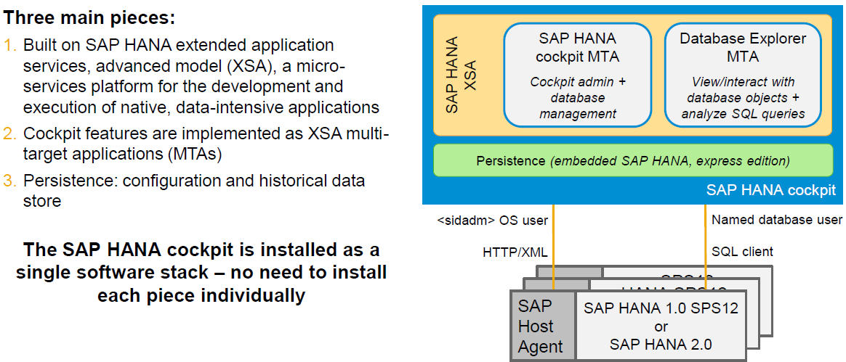
SAP HANA Cockpit Simplified architecture

Slide 5
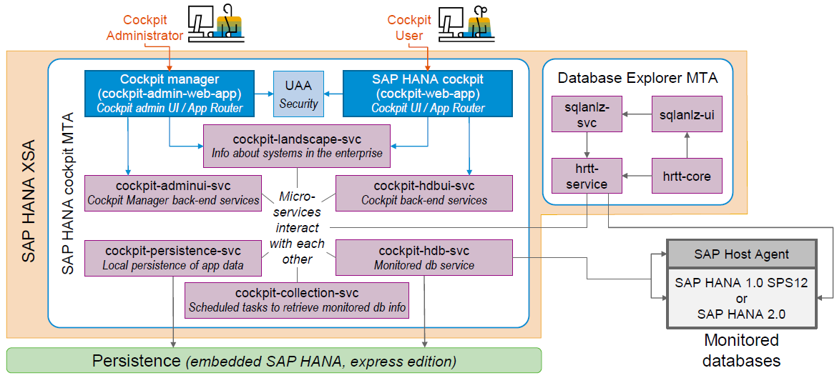
SAP HANA Cockpit Internals

Slide 6
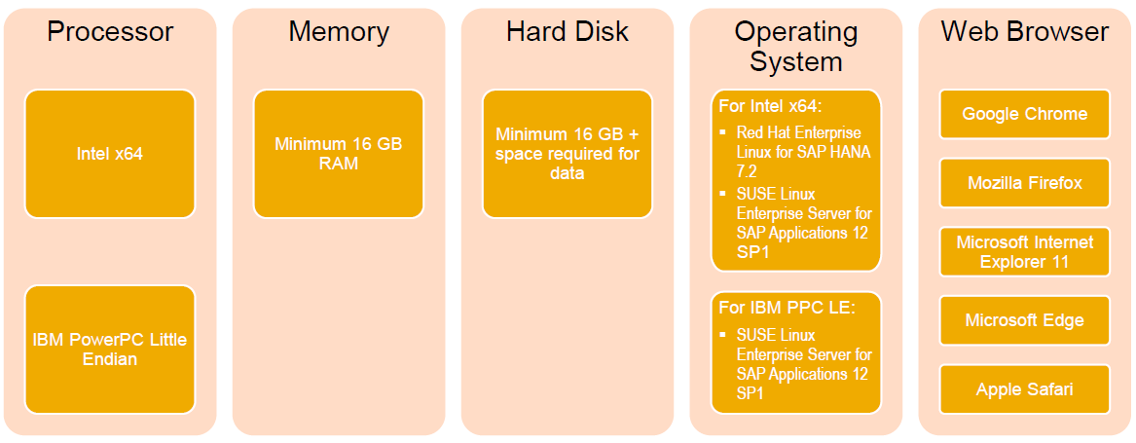
SAP HANA Cockpit System requirements

Slide 7
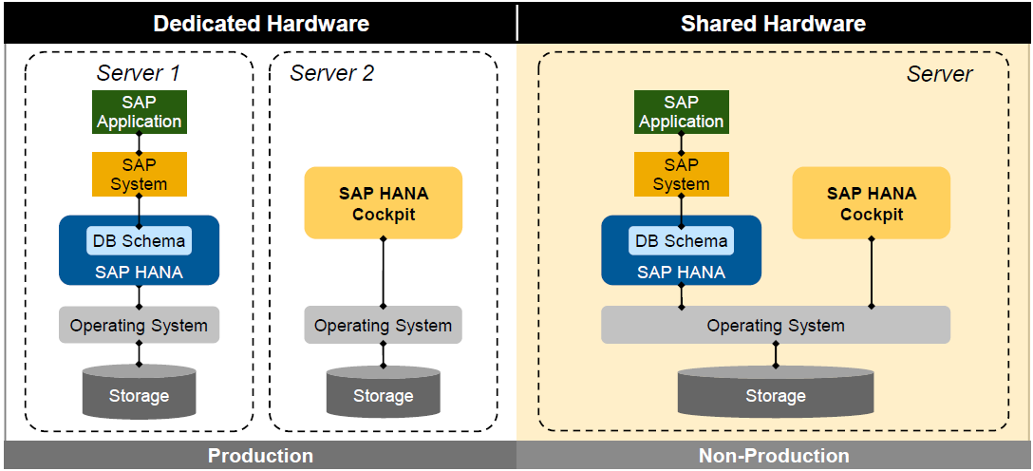
SAP HANA Cockpit Deployment scenarios

Slide 8
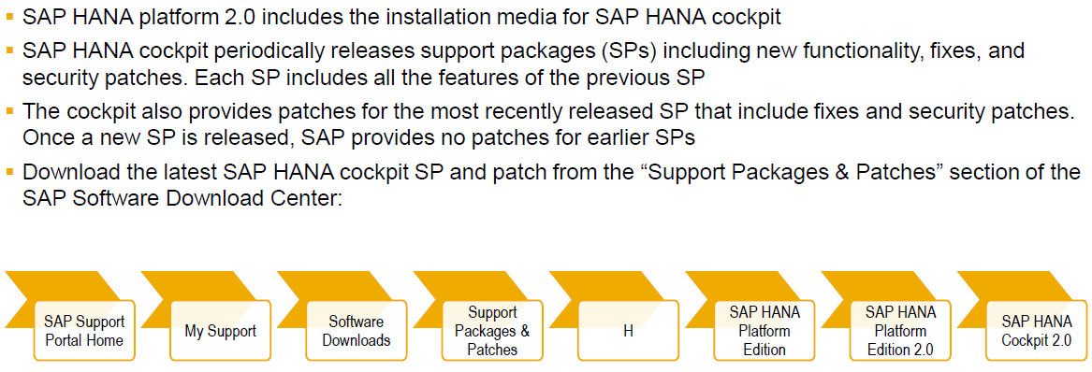
SAP HANA Cockpit Getting started – Download

Slide 9
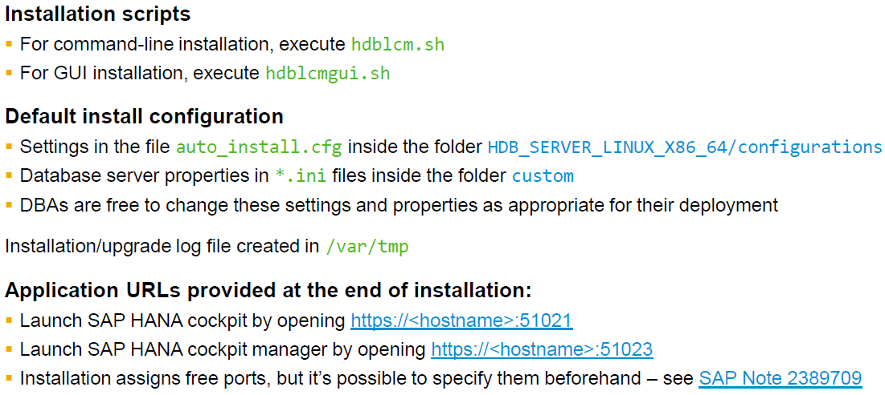
SAP HANA Cockpit Getting started – Installation

Slide 10
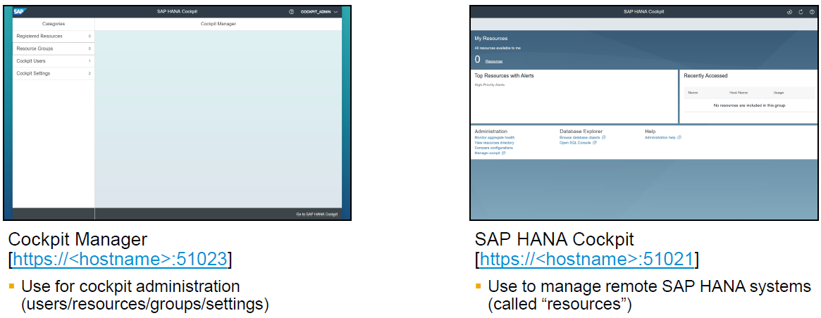
SAP HANA Cockpit Launching cockpit manager and SAP HANA cockpit

Slide 11
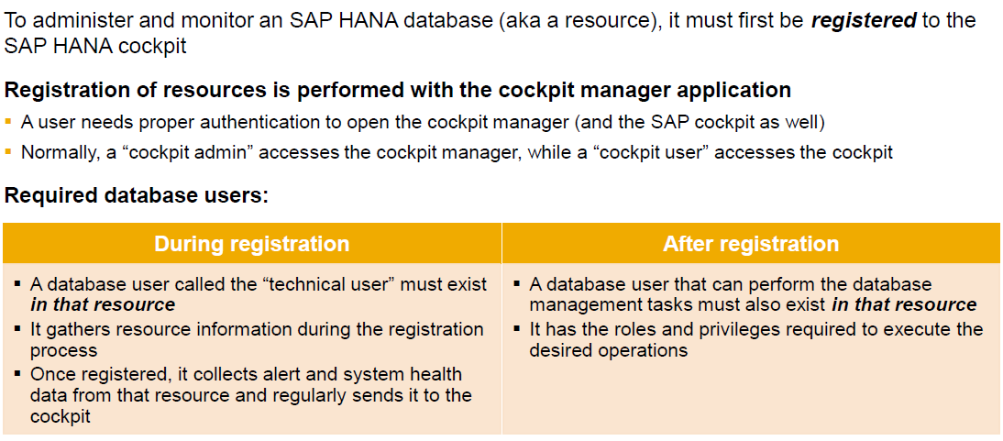
Registering Resources to Manage The registration process

Slide 12
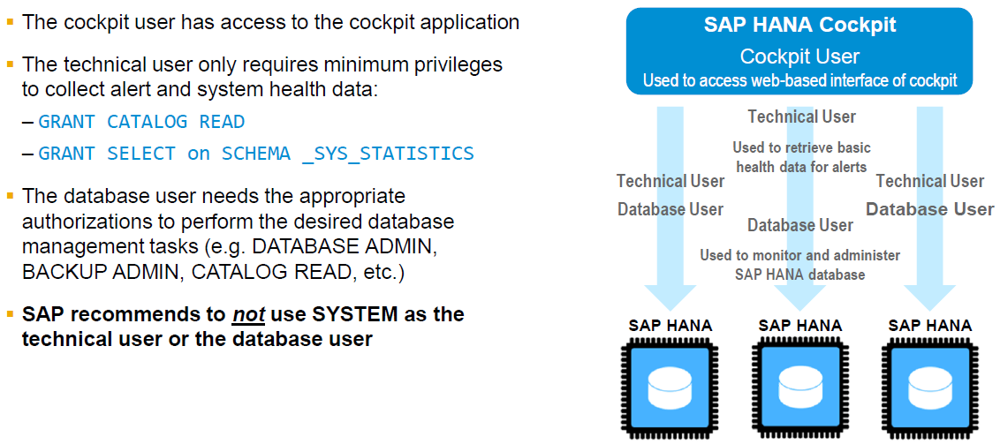
Registering Resources to Manage SAP HANA cockpit security model

Slide 13
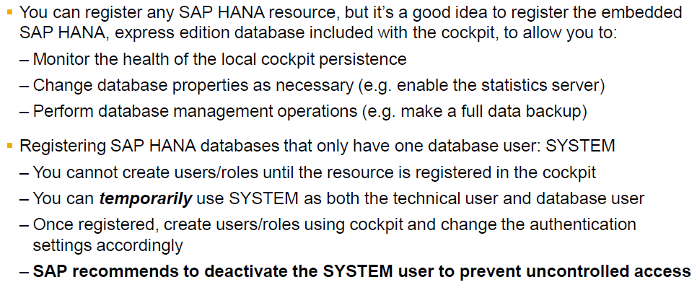
Registering Resources to Manage Registering your first resource

Slide 14
More on SAP HANA Cockpit
SAP HANA 2.0 Cockpit Installation and Configuration How to Guide
SAP HANA 2.0 Cockpit FAQ
SAP HANA Cockpit 2.0 SP 05 What’s New
SAP HANA Administration with SAP HANA Cockpit

